Slide 1

Job Analytics
PRESENTATION ON
To be done on Linkedin

Slide 2



Specifically a team project that is to be done multiple platforms like :
Python: for scraping the data from LinkedIn
SQL: for analysis and insight creation
Excel: for visualization purpose and Dashboard creation

Slide 3
Task was divided into team members in the following order:
Abhiraj: scraping the data for processing
Amrita: processing the data for analysis & generating insight
Ishika: processing data for creation of Dashboard
Quaireshi Fareed: dashboard final touches and presentation

Slide 4
Final table
After web scraping and visualising it through sql
has these many features:
company_id
details_id
job_id
company_name
title
industry
level
involvement
job -applicant
City
State
Country
Count of job application

Slide 5
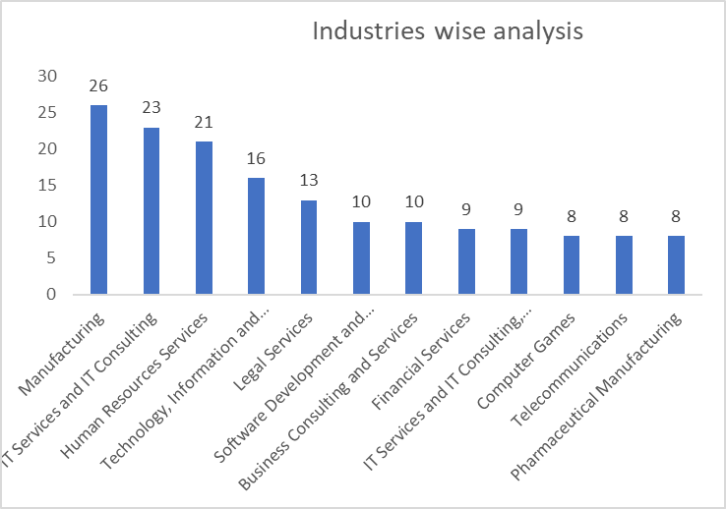
From the below mentioned graph we can easily find the top 10 types of industries

Slide 6
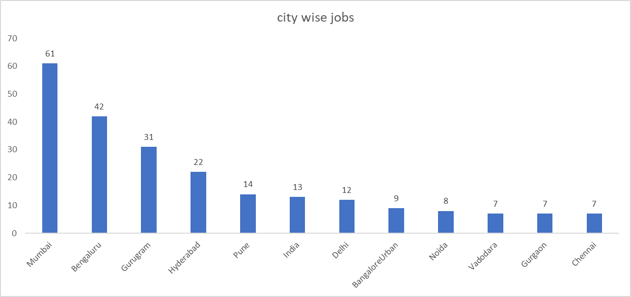
Top 10 major cities for which most of the job applications are posted:

Slide 7
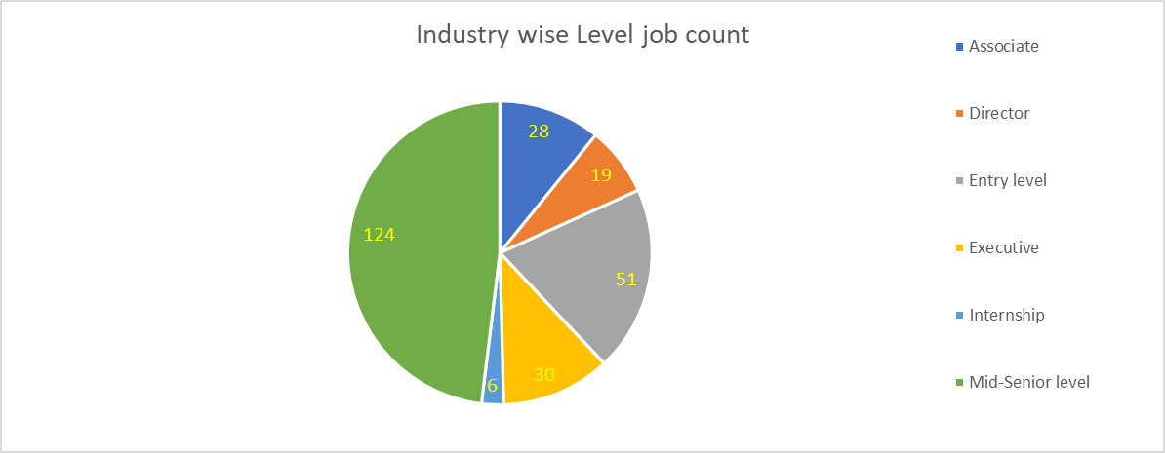
Level (position) wise job count on linkedin

Slide 8
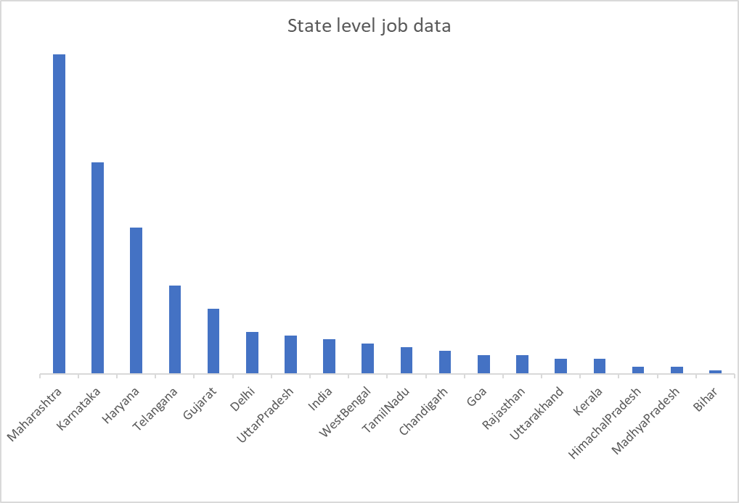
In India below mentioned are the major states for which jobs are available

Slide 9
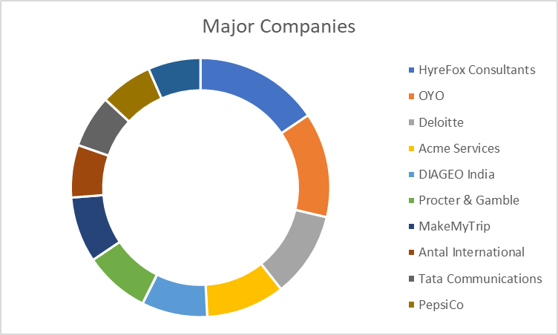
Top 10 major companies on Linkedin site are mentioned below:

Slide 10
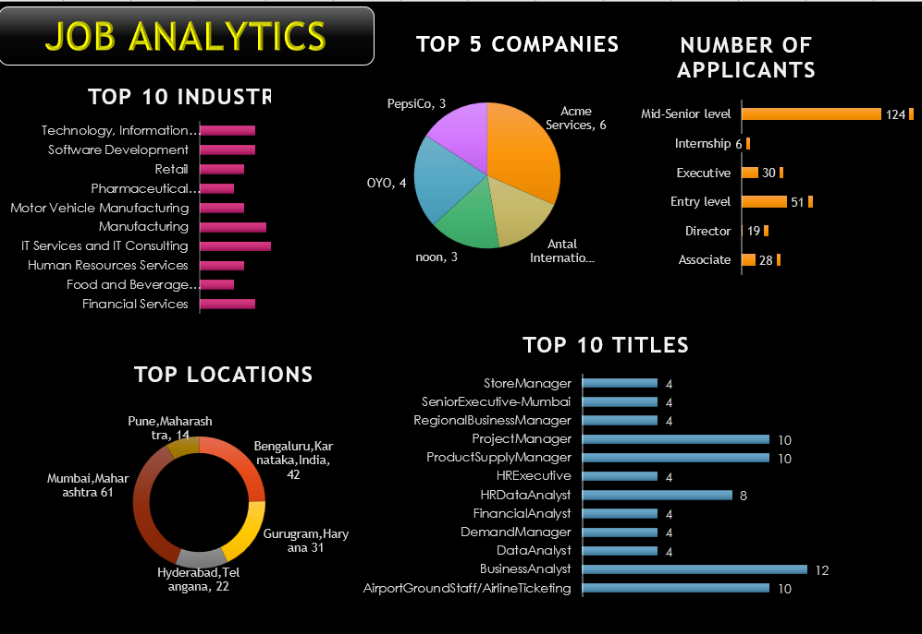

Slide 11
Findings & Insights
Some of the major insights are mentioned below:
Technical, legal and service industry has major opportunities for the job. So more and more courses and educational institute can be opened that will not only create the job but also fulfill these job requirements.
Bangalore, Mumbai, Hyderabad, Pune, Delhi are the major locations for which jobs are posted. Major focus is being given to develop these areas and also focus should be given to other states as well by taking example of these states.
Less jobs are available for internship whereas abundance for mid-senior level which means once you enter in industry and attain the required skills can easily reach to the higher levels.
More you search better you will get. Overall skills, knowledge and experiences are the key factors for most of the jobs posted on LinkedIn.

